Slide 1
CSCI 8360: Data Science Practicum
Lecture 1
Dr. Shannon Quinn

Slide 2
Part I: Lightning Overview
CSCI 8360 Data Science Practicum

Slide 3
Data Science
What is it?
Why is it important?
How does one learn it?

Slide 4
CSCI 8360: What Is It?
What this class is NOT
What this class IS
Introduction to Machine Learning
Introduction to Distributed Systems
Introduction to Software Engineering
Hands-on data science
Team-based problem solving
“Kaggle in the Classroom”

Slide 5
CSCI 8360 Requirements
Thorough understanding of machine learning and statistics
(or teammates who can bring you up to speed very quickly)
Good software engineering skills
(working on teams)
An ability to learn fast
(definition of “graduate student”)

Slide 6
CSCI 8360 Links
Course website
https://dsp-uga.github.io/sp18
Lectures and assignments will be posted here
Slack
https://eds-uga-csci8360.slack.com
This is where all course communication will happen
GitHub
https://github.com/dsp-uga/
All team development will happen here (part of your grade)
AutoLab
https://autolab.cs.uga.edu
Project submissions for grading and evaluation
Google Compute Platform (GCP)
Everyone will get credits

Slide 7
Course Outline
4 Projects (+ a pseudo-project), each 2-3 weeks
1 Final Project
Lecture every Wednesday
Office hours Tuesday/Thursday
No exams!
Attendance

Slide 8
Part II: Administrative Details
CSCI 8360 Data Science Practicum

Slide 9
Lectures, Revisited
Location: Boyd 208
Time
Today, 11:00am – 12:15pm
Next Tuesday (January 9), 11:00am – 12:15pm
Every Wednesday, 11:15am – 12:05pm
NO OTHER LECTURE TIMES (unless announced in Slack)

Slide 10
Office Hours, Revisited
Location: Boyd 208
Time: Tuesdays / Thursdays, 11:00am – 12:15pm
(yep, when we’d otherwise have lecture, so I know you can’t possibly have conflicts)
Happy to set up appointments if you need them

Slide 11
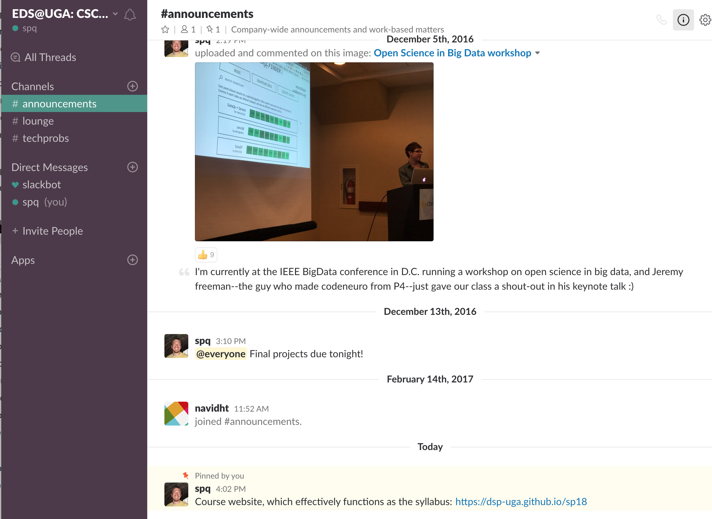
Slack, Revisited
Slack: free team messaging platform
Web-based and mobile apps
Teams can set up private direct chats to coordinate
Can also send individual DMs
All course announcements will be made here

Slide 12
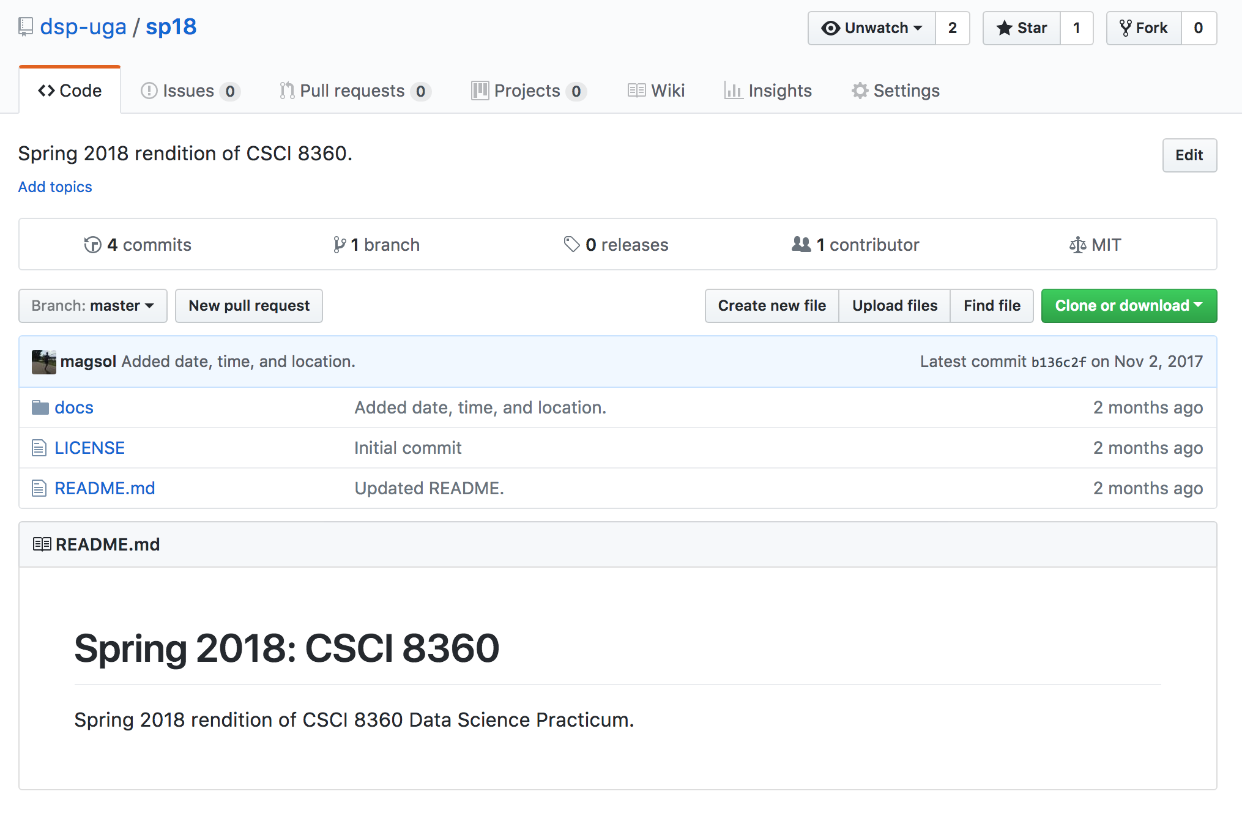
GitHub, Revisited
Most popular code repository in the world
Uses the git concurrent versioning system (itself an open source project)
Lots of useful team-based tools (issue tracker, wiki, GUI)
All projects will be sourced in the DSP-UGA GitHub organization

Slide 13
AutoLab, Revisited
Assignment submission and autograder
Also has leaderboards!
All project outputs will be submitted to AutoLab for ranking

Slide 14
Google Cloud Platform
(comparable to Amazon Web Services, or AWS)
Spin up elastic compute resources on-demand
Every student gets $50 in credits (usable across ALL services)
“Cloud Dataproc” contains APIs for specifically spinning up Spark and Hadoop clusters
Details to come

Slide 15
Part III: Projects
CSCI 8360 Data Science Practicum

Slide 16
Project Overview
Solving real-world machine learning problem
Classify a large corpus of documents
Convex optimization over a huge dataset
Dimensionality reduction over a high-dimensional matrix
etc.
Each project varies in length from 2 to 3 weeks
“Introductory” Project 0 out next Tuesday, will be only 1 week long
Project 1 (P1) out the following Tuesday (Jan 16), will be 2.5 weeks long

Slide 17
Project Requirements: Teams
Teams (2-3 people per team)
Assigned completely randomly (by me)
Will change for each project
(you can form your own teams for the final project)
Each team member should have a clear, well-defined role
Not everyone has to be a coder!
But 1 person should not be carrying the whole project

Slide 18
Project Requirements: Code
Use good coding practices
Documentation (in code, in GitHub wiki, in README, in commit comments)
Well-organized structure (should be easy for me to understand)
Use organizational GitHub account
https://github.com/eds-uga
Recommended additional practices
License your code with a permissive open license (https://choosealicense.com/ )
Add a continuous integration module (https://travis-ci.org/ )
Implement unit testing for your code
Create a website for your project (see GitHub documentation; makes this easy)

Slide 19
Project Requirements: AutoLab
Submit to AutoLab before the deadline
One submitter per team (can submit as many times as you like)
Unless otherwise specified, submission will always be a text file with your code’s predictions on a test dataset
If your submission is correctly formatted, your performance should show up on the leaderboard in short order
AutoLab submission shuts down after the deadline

Slide 20
Project Requirements: Lightning Talks
Wednesdays after a project deadline, all teams will give a lightning talk (~4-6 minutes long)
Talks will outline the problem, the team’s approach, their results, and any other discussion points
Creativity welcome—code examples, live demos, interactive slides, etc
One person from each team will speak

Slide 21
Project Grading
Everyone starts at an 85% (solid B)
Grading split into three categories
Theory (the approach you use as implemented by the code)
Engineering (everything around the implementation)
“Extras”
Go above and beyond—extra points
Shortcomings (approach is flawed or too simple, code poorly documented, one person did almost all of the project, poor leaderboard ranking) reduce points
Grading report will be issued to each team shortly after the project deadline

Slide 22
Final Project
Also team-based, 2-3 people (but you choose your own teams)
Includes proposal + final write-up + final presentation components
Presentations will happen the week of April 16 (last two weeks of classes)
More details to come!

Slide 23
Part IV: The Next Step
CSCI 8360 Data Science Practicum

Slide 24
Project -1 (P-1)
Email me ( squinn@cs.uga.edu ) with your preferred email to send a Slack invite. Join the Slack team.
Send me your GitHub username (create an account if you don’t have one). Join the GitHub “Data Science Practicum” team.
Start looking at Apache Spark (for Project 0 next week).

Slide 25
Next week: Project 0
The only individual project of the semester
Mainly to familiarize you with Apache Spark (used for Projects 1 and 2, possibly for 3 and 4 as well), AutoLab, GitHub, and Slack
Won’t count for a grade, but is required

Slide 26
Questions?

Slide 27
Finally…
Your idea could be featured as a full project!
What large-scale problems do you want to work on?
Yes, this an opportunity to suggest Projects. If you have an idea, send me:
The problem to be solved (optimization, dimensionality reduction, classification, etc)
How the solutions should be evaluated
Training and validation datasets

